Slide 1
Engineering Chemistry
Dr. Bhavna Mukesh Vyas

Slide 2
Unit 1: Impurities in Water
Types of Impurities present in Water:
Dissolved Impurities: Cations like Ca⁺⁺ , Mg ⁺⁺, Na ⁺ , Zn⁺⁺ , Cu⁺⁺ and anions like Cl ⁻ , SO₄ ⁻⁻, NO₃ ⁻, HCO₃ ⁻ , F⁻ (of Inorganic salts), Gases such as CO₂, O₂, N₂, oxides of N₂, NH₃, H₂S and Organic salts
Suspended Impurities: Clay & Sand (Inorganic), leaves, twigs etc
Colloidal Impurities: oil globules, animal and vegetable matter (Organic)
Bacterial Impurities: Bacteria, microorganisms & other forms of animal and plant life
Types of Water: Hard Water & Soft water

Slide 3
Unit 1: Impurities in Water
Removal of Impurities present in Water:
Dissolved Impurities: Removed by softening methods like ion exchange, lime-soda treatment and reverse osmosis
Suspended Impurities: Alters the taste, Organic matter can be removed by screening, filtration, coagulation and sedimentation.
Colloidal Impurities: Not easy to settle and impart colour and turbidity, Removal of oil globules, animal mater, humic acids etc require specific chemical treatment
Bacterial Impurities: Causes diseases and also impart colour, odour and turbidity. Water can be Disinfected by chlorination and boiling
Types of Water: Hard Water & Soft water

Slide 4

Unit 1: Dissolved Mineral Matter in Water
Most Important dissolved mineral matter in water
from Industrial application point of view): Hardness & Alkalinity
Hardness: Defined as soap consuming capacity of a water sample (mainly due to the presence of Ca & Mg ions)
What are Soaps?
Soaps are sodium salts of long chain fatty acids such as oleic acid, palmitic and stearic acid
Ca & Mg ions react with sodium salts of long chain fatty acids present in the soap to form insoluble scums of calcium and magnesium soaps which do not possess any detergent value
(does not produce lather or foam)
$${2C_{17}H_{35}COONa+CaCl}_{2}→{\left(C_{17}H_{35}COO\right)}_{2}Ca+2NaCl$$
Notes:
Hardness is measure of polyvalent cations (ions with a charge greater than +1) in water. Hardness generally represents the concentration of calcium (Ca²⁺) and magnesium (Mg²⁺) ions, because these are the most common polyvalent cations. Other ions, such as iron (Fe²⁺) and manganese (Mn²⁺), may also contribute to the hardness of water, but are generally present in much lower concentrations. Waters with high hardness values are referred to as "hard," while those with low hardness values are "soft".
Hardness affects the amount of soap that is needed to produce foam or lather. Hard water requires more soap, because the calcium and magnesium ions form complexes with soap, preventing the soap from sudsing. Hard water can also leave a film on hair, fabrics, and glassware. Hardness of the water is very important in industrial uses, because it forms scale in heat exchange equipment, boilers, and pipe lines. Some hardness is needed in plumbing systems to prevent corrosion of pipes.
Hardness mitigates metals toxicity, because Ca²⁺ and Mg²⁺ help keep fish from absorbing metals such as lead, arsenic, and cadmium into their bloodstream through their gills. The greater the hardness, the harder it is for toxic metals to be absorbed
Water hardness is commonly defined as the sum of the polyvalent cations dissolved in the water. The most common such cations are calcium and magnesium. Hardness is usually reported as an equivalent quantity of calcium carbonate (CaCO3). Generally, waters are classified according to degree of hardness. The hardness of your water will be reported in milligrams per liter (mg/l).

Slide 5
Water hardness is classified by the U.S. Department of Interior and the Water Quality Association as follows:
Classification mg/l or ppm
Soft 0 - 17.1
Slightly hard 17.1 - 60
Moderately hard 60 - 120
Hard 120 - 180
Very hard 180 & over

Slide 6
S.No. | Parameters | Drinking water IS 10500 : 2012
 |  | Permissible Limit | Maximum Limit
1 | Odor | Agreeable | Agreeable
2 | Taste | Agreeable | Agreeable
3 | pH | 6.5 to 8.5 | No relaxation
4 | TDS (mg/l) | 500 | 2000
5 | Hardness (as CaCO3) (mg/l) | 200 | 600
6 | Alkalinity (as CaCO3) (mg/l) | 200 | 600
7 | Nitrate (mg/l) | 45 | No relaxation
8 | Sulfate (mg/l) | 200 | 400
9 | Fluoride (mg/l) | 1 | 1.5
10 | Chloride (mg/l) | 250 | 1000
11 | Turbidity (NTU) | 5 | 10
12 | Arsenic (mg/l) | 0.01 | 0.05
13 | Copper (mg/l) | 0.05 | 1.5
14 | Cadmium (mg/l) | 0.003 | No relaxation
15 | Chromium (mg/l) | 0.05 | No relaxation
16 | Lead (mg/l) | 0.01 | No relaxation
17 | Iron (mg/l) | 0.3 | No relaxation
18 | Zinc (mg/l) | 5 | 15
19 | Fecal Coliform (cfu) | 0 | 0
20 | E. Coli (cfu) | 0 | 0

Slide 7
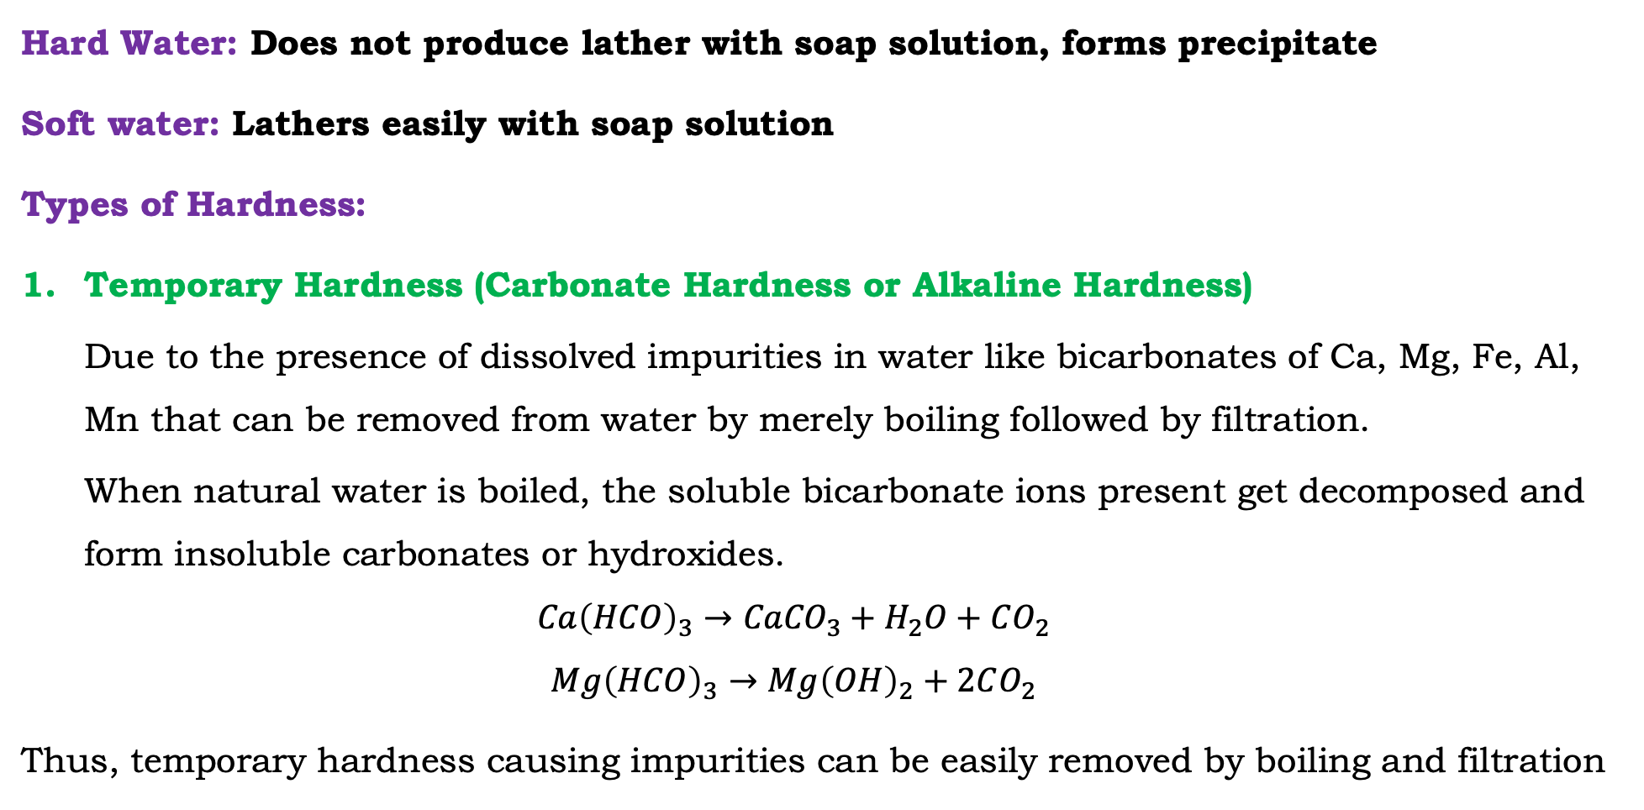
Unit 1: Hardness of Water
Hard Water: Does not produce lather with soap solution, forms precipitate
Soft water: Lathers easily with soap solution
Types of Hardness:
Temporary Hardness (Carbonate Hardness or Alkaline Hardness)
Due to the presence of dissolved impurities in water like bicarbonates of Ca, Mg, Fe, Al, Mn that can be removed from water by merely boiling followed by filtration.
When natural water is boiled, the soluble bicarbonate ions present get decomposed and form insoluble carbonates or hydroxides.
$${Ca\left(HCO\right)}_{3}→{CaCO}_{3}+H_{2}O+CO_{2}$$
$${Mg\left(HCO\right)}_{3}→{Mg\left(OH\right)}_{2}+2CO_{2}$$
Thus, temporary hardness causing impurities can be easily removed by boiling and filtration

Slide 8





Slide 9
Unit 1: Hardness of Water
Hard Water: Does not produce lather with soap solution, forms precipitate
Soft water: Lathers easily with soap solution
Types of Hardness:
Temporary Hardness (Carbonate Hardness or Alkaline Hardness)
Due to the presence of dissolved impurities in water like bicarbonates of Ca, Mg, Fe, Al, Mn that can be removed from water by merely boiling followed by filtration.
When natural water is boiled, the soluble bicarbonate ions present get decomposed and form insoluble carbonates or hydroxides.
$${Ca\left(HCO\right)}_{3}→{CaCO}_{3}+H_{2}O+CO_{2}$$
$${Mg\left(HCO\right)}_{3}→{Mg\left(OH\right)}_{2}+2CO_{2}$$
Thus, temporary hardness causing impurities can be easily removed by boiling and filtration

Slide 10
Unit 1: Hardness of Water
Types of Hardness:
2. Permanent Hardness (Non-Carbonate Hardness or Non-Alkaline Hardness)
Due to the presence of dissolved impurities in water like chlorides, sulphates and nitrates of Ca, Mg, Fe, Al, Mn etc.
These salts cannot be removed by merely boiling, needs special water softening methods
to remove permanent hardness of water.
Temporary and permanent hardness together called as total hardness of water.
Total Hardness = Temporary Hardness + Permanent Hardness

Slide 11
Unit 1: Hardness of Water
Degree of Hardness:
Total hardness present in water is because of different salts of calcium and magnesium with different molecular weights.
Hence, hardness of water is conveniently expressed in terms of calcium carbonate equivalence.
The weights of different salts causing hardness are converted to weight equivalent to that of calcium carbonate.
If a water sample contains 2 or more salt their quantities are converted to calcium carbonate equivalence and the sum will give total hardness in terms of calcium carbonate equivalence.

Slide 12
Unit 1: Hardness of Water
Degree of Hardness:
Degree of hardness is defined as the number of parts by weight of calcium carbonate hardness per particular number of parts of water, depending upon the unit employed.
Though the hardness does not always arise due to calcium carbonate in water, it is a standard practice to express it in terms of equivalents of CaCO_{3.} WHY ?????
Calcium carbonate is selected for expression of degree of hardness because:
its molecular weight is exactly 100 which makes calculation convenient
it is the most insoluble salt that can be precipitated out of water

Slide 13
Unit 1: Hardness of Water
Degree of Hardness:
The CaCO₃ equivalent for any dissolved salt in water can be calculated as:
$$\text{CaCO}\text{3} \text{equivalent} \text{of} \text{any} \text{salt}\text{ = }\text{Weight} \text{of} \text{salt} \text{present}\text{ (}\text{mg}\text{/}\text{l}\text{) }× \frac{Equivalent weight of CaCO_{3}}{Equivalent weight of salt}$$
$$\text{CaCO}\text{3} \text{equivalent} \text{of} \text{bivalent} \text{salt}\text{ = }\text{Weight} \text{of} \text{salt} \text{present}\text{ (}\text{mg}\text{/}\text{l}\text{) }× \frac{Molecular weight of CaCO_{3}}{Molecular weight of salt}$$

Slide 14
Unit 1: Hardness of Water
Units of Hardness:
Parts per Million (ppm): It is the number of equivalent parts of CaCO₃ present per million parts (10⁶) parts of water by weight
Milligram per liter (mg/l): It is the number of mg of CaCO₃ dissolved in 1 litre of water.
Degree Clarke (⁰Cl): It is the number of equivalent parts of CaCO₃ present per 70,000 parts of water or 1 gallon of water
Degree French (⁰Fr): It is the number of equivalent parts of CaCO₃ present per 10⁵ parts of water 1 mg/l = 1 ppm (Prove)
Notes:
1 Litre water weighs 1Kg = 1000 * 1000 mg
1 mg/l = 1 mg of CaCO3 per 10 to the power 6 mg of water
= 1 part of CaCO3 per 10 to the power 6 parts of water
= 1 ppm

Slide 15




Numericals: Hardness of Water
Notes:
1 Litre water weighs 1Kg = 1000 * 1000 mg
1 mg/l = 1 mg of CaCO3 per 10 to the power 6 mg of water
= 1 part of CaCO3 per 10 to the power 6 parts of water
= 1 ppm

Slide 17
Unit 1: Chemical analysis of water
Determination of Hardness of Water by EDTA Method:
The hardness of water can be determined by complexometric titration.
Complexometric titrations involve formation of a soluble complex between a metal ion and a complexing agent.
Metal ion is called the central atom and the complexing agent is called the ligand. The ligands can be unidentate, bidentate or polydentate having one, two and more than two donor atoms respectively which can form stable complexes.
The polydentate ligands form stable complexes with wide variety of metals as these ligands form ring structures called chelates.
EDTA is used as complexing agent in determination of hardness of water

Slide 19
Unit 1: Chemical analysis of water
Determination of Hardness of Water by EDTA Method:
Ethylene Diamine Tetra Acetic acid (EDTA) is one of the notable ligands used as complexing reagent.
EDTA has six potential sites (hexadentate) for bonding a metal ion, the two amino groups and four carboxy group. When EDTA is dissolved in water, it forms zwitterion (an ion with a positive and a negative electrical charge at different locations within a molecule). The various EDTA species are abbreviated as H₄Y, H₃Y⁻, H₂Y²⁻, HY³⁻ and Y⁴⁻. EDTA forms stable complexes (chelates) with the metal ions.
Because of limited solubility of EDTA, the disodium salt Na₂H₂Y is used for analytical work (high state of purity as the dihydrate)

Slide 20
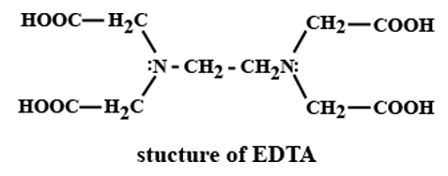
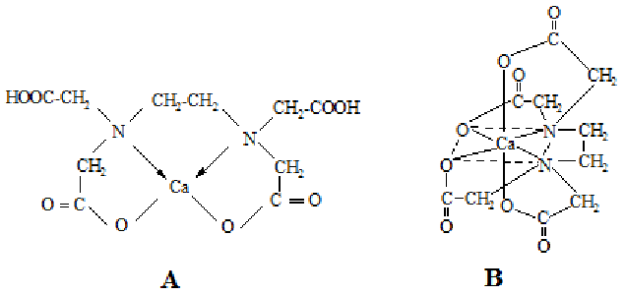
Structure of EDTA & Ca-EDTA Chelate
https://www.toppr.com

Slide 21
Unit 1: Chemical analysis of water
Principle of EDTA Method:
EDTA forms stable complexes (chelates) with the hardness causing metal (Ca or Mg) ions.
Hard water titrated against Na₂EDTA in a complexometric titration.
Eriochrome Black-T (EBT) indicator is used in complexometric titration. EBT is pH sensitive indicator and effective in alkaline condition (about pH 10).
Ammoniacal Buffer solution (NH₄OH+NH₄Cl) is used to maintain pH of about 10 during a complexometric titration.
EDTA a complexometric titration works as follows:

Slide 22
Unit 1: Chemical analysis of water
Principle of EDTA Method:
EDTA solutions are used as Titrant in complexometric titration.
Indicator EBT, which is a blue-coloured dye, forms an unstable & soluble wine-red color complex with Ca and Mg ions in hard water at a pH of 9 to 10.
When unstable wine-red color complex is treated with EDTA solution, EDTA being more sensitive replaces Ca²⁺ and Mg²⁺ ions from the unstable indicator complex to form a stable complex, with the result, indicator is set free giving its original blue color.
[Mg²⁺ / Ca²⁺ - EBT] + EDTA $→$ [Mg²⁺ / Ca²⁺ - EDTA] + EBT
(Wine-red) (Colourless) (Blue)
Thus, in EDTA complexometric titration using EBT indicator, the end point is wine-red turns blue
Thus, the amount of EDTA consumed in titration corresponds to the hardness of water.

Slide 23
Unit 1: Chemical analysis of water
Reactions:
Ca²⁺ / Mg²⁺ + EBT $→$ Ca²⁺- EBT / Mg²⁺ - EBT
Colourless Wine Red Unstable Complex
Ca²⁺/Mg²⁺ + EDTA $→$ Ca²⁺ - EDTA /Mg²⁺ - EDTA
Colourless Stable Complex
[Mg²⁺ / Ca²⁺ - EBT] + EDTA $→$ [Mg²⁺ / Ca²⁺ - EDTA] + EBT
Wine Red Complex Colourless Stable Complex Blue

Slide 24
Unit 1: Chemical analysis of water
Procedure to find Total Hardness of Water Volumetrically:
Standardisation of EDTA:
Prepare standard ZnSO₄ solution (of exact M₁ molarity)
Fill the burette with EDTA solution (of approximate M₂ molarity)
Pipette out V₁ ml of standard ZnSO₄ solution in a conical flask
Add one-third test tube of ammoniacal buffer solution and few drops of EBT indicator
Wine red coloured solution is then titrated against EDTA solution from burette till colour changes to blue.
Note down the end point as V₂ ml (EDTA consumed)
(Standardisation: To get the Exact molarity of EDTA solution using primary standard substance )

Slide 25
Unit 1: Chemical analysis of water
Procedure to find Total Hardness of Water Volumetrically:
2. Estimation of total hardness of water:
Fill the burette with EDTA solution
Pipette out V ml of hard water in a conical flask
Add one-third test tube of ammoniacal buffer solution and few drops of EBT indicator
Wine red coloured solution is then titrated against EDTA solution from burette till colour changes to blue.
Note down the end point as ‘Y’ ml (volume of EDTA consumed)

Slide 26
Unit 1: Chemical analysis of water
Procedure to find Total Hardness of Water Volumetrically:
3. Calculations to find total hardness of water:
For standardisation of EDTA: Using, M₁V₁= M₂V₂ (ZnSO₄ vs EDTA)
Exact Molarity of EDTA can be found out.
Calculation of total hardness of water: EDTA forms 1 : 1 complex with Ca and Mg ions
1 mole of EDTA = 1 mole of CaCO₃
1000 ml of 1 M EDTA = 100 g of CaCO₃
1 ml 1 M EDTA = 100 mg of CaCO₃
‘CBR’ ml M₂ EDTA = 100 x ‘CBR’ x M₂ mg of CaCO₃
V ml water sample contains = ….. mg of CaCO₃
$Hardness of water sample=\frac{100∗Volume of EDTA consumed(ml)∗Molarity of EDTA∗1000}{Volume of water sample (ml)} ppm$

Slide 28
Numericals
250 mL of a water sample on EDTA titration with Eriochrome Black –T consumed 13 mL of 0.022 N EDTA till end point is reached. Calculate the hardness of water.
(Hardness = 114.4 ppm)
100 mL of a sample of water required 15 mL of 0.01 M EDTA for titration using Eriochrome Black –T as indicator. In another experiment, 100 mL of the same sample was boiled to remove the temporary hardness, the precipitate was removed and the cold solution required 8 mL of 0.01 M EDTA using Eriochrome Black –T as indicator. Calculate the total hardness, permanent hardness and temporary hardness in mg/L of CaCO3 equivalent.
(Total Hardness = 150 ppm, PH=80 ppm & TH=70ppm)

Slide 29
Numericals
3. 100 mL of the hard water sample required 35 mL of the same EDTA solution on titration. After boiling 100 mL of this water, cooling, filtering and then titration required 10 mL of EDTA solution. Calculate the temporary and permanent hardness of water.
(Total hardness = 350 ppm, Permanent Hardness = 100 ppm, Temporary Hardness = 250 ppm )

Slide 30
Alkalinity of water
Alkalinity is a measure of the ability of water to neutralize the acids
The alkalinity of water is normally due to the presence of bicarbonates, carbonates and hydroxides of sodium, potassium, calcium and magnesium.
Some of the salts, which cause alkalinity, also cause hardness, but not all. (However, the presence of other bases such as borates, silicates, phosphates can also contribute to the total alkalinity, though to a small extent)

Slide 31
Alkalinity of water
Classification of Alkalinity: Alkalinity based on the anions present in the water is classified as:
Caustic Alkalinity (due to Hydroxide and Carbonate ions)
Bicarbonate Alkalinity (due to Bi-carbonate ions)
Alkalinity of a water sample due to different ions can be determined by neutralization titration using a standard acid and making selective use of indicators. The indicators used are Phenolphthalein and Methyl orange.

Slide 32
Alkalinity of water
Reactions: The determination is based on following reactions
OH⁻ + H⁺ ⇢ H₂O
CO₃⁻ ⁻ + H⁺ ⇢ HCO₃⁻
HCO₃⁻ + H⁺ ⇢ H₂CO₃
Reaction 1 and 2 corresponds to Phenolphthalein (P) end point i.e. complete neutralization of OH⁻ and half neutralization of CO₃⁻ ⁻
Reaction 1 to 3 corresponds to Methyl Orange (M) end point i.e. complete neutralization of OH^{- ,} CO₃⁻ ⁻ and HCO₃⁻ ions.

Slide 33
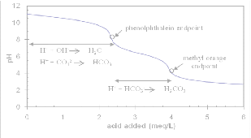

Slide 34
Alkalinity of water
Alkalinity may be due to presence of following combinations:
Alkalinity due to HCO₃⁻ only
Alkalinity due to, CO₃⁻ ⁻ only
Alkalinity due to, OH^{- ,} only
Alkalinity due to, CO₃⁻ ⁻ and HCO₃⁻ ions
Alkalinity due to, OH⁻ and CO₃⁻ ⁻
The possibility of OH– and HCO₃– together is ruled out, they combine instantaneously to form CO₃⁻ ⁻ ions, thus all ions cannot exist together.
Thus, on the basis of Phenolphthalein alkalinity and methyl orange alkalinity, the alkalinity in water due to different ions can be calculated.

Slide 35
Alkalinity of water
Procedure:
Pipette out 100 mL of the water sample in a clean titration flask.
Add 2–3 drops of phenolphthalein indicator.
Run in N/50 H₂SO₄ or HCl (from a burette), till the pink color is just discharged. This is the first end point.
Let the volume of acid used until phenolphthalein end point = V₁ mL.
Then to the same solution, add 2 to 3 drops of methyl orange. Continue titration, till the yellow colour changes to orange/red. This is the second end point.
Let volume of acid used to methyl orange end point = V₂ mL.

Slide 36
Alkalinity of water
OBSERVATIONS:
Volume of water sample (unknown alkalinity) selected = _ ml
For Phenolphthalein end point
Burette: HCl solution of _________N
Indicator: Phenolphthalein
End point: Pink turns colourless
Volume of titrant (HCl) consumed, V₁ = ______ml
For Methyl orange end point
Burette: HCl solution of _________N
Indicator: Methyl Orange
End point: Yellow turns orange/red
Volume of titrant (HCl) consumed, V₂ = ______ml

Slide 37
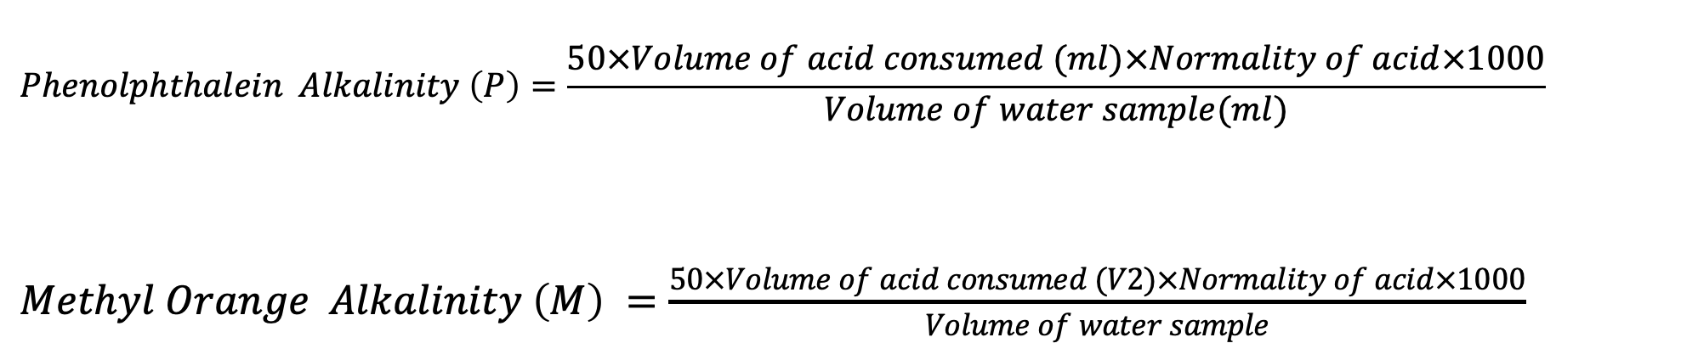
Alkalinity of water
CALCULATIONS:
$$Phenolphthalein Alkalinity \left(P\right)=\frac{50×Volume of acid consumed (ml)×Normality of acid×1000}{Volume of water sample(ml)}$$
$Methyl Orange Alkalinity \left(M\right) =\frac{50×Volume of acid consumed (V2)×Normality of acid×1000}{Volume of water sample}$
From the measurement of Phenolphthalein alkalinity and methyl orange alkalinity, it is possible to calculate the magnitude of various forms of alkalinity present in water sample,

Slide 38
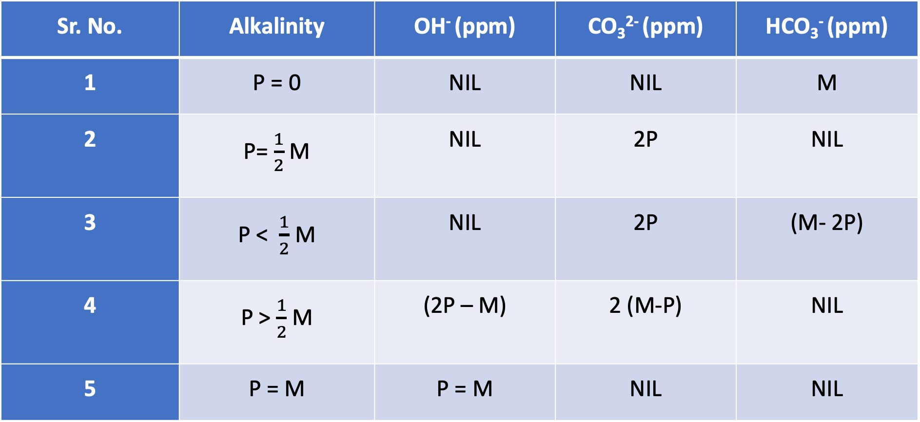
Alkalinity of water
Sr. No. | Alkalinity | OH⁻ (ppm) | CO₃²⁻ (ppm) | HCO₃⁻ (ppm)
1 | P = 0 | NIL | NIL | M
2 | P= $\frac{1}{2}$ M | NIL | 2P | NIL
3 | P < $\frac{1}{2}$ M | NIL | 2P | (M- 2P)
4 | P > $\frac{1}{2}$ M | (2P – M) | 2 (M-P) | NIL
5 | P = M | P = M | NIL | NIL

Slide 39
Alkalinity of water
(i) When P = 0, both OH– and CO₃^{2–} are absent and alkalinity in that case is due to HCO₃– alone.
(ii) When P = M neither CO₃^{2–} nor HCO₃– ions are present, only OH– ions are present, Thus alkalinity due to OH– = P = M.
(iii) When P = 1/2 M or V₁ = V₂/2, only CO₃^{2–} is present,
since half of carbonate neutralisation (ie CO₃^{2–} + H⁺ → HCO₃– ) takes place with phenolphthalein, while complete carbonate neutralisation (CO₃^{2–} + H⁺ → HCO₃– ; HCO₃– + H⁺ → H₂O + CO₂) occurs when methyl orange indicator is used. Thus, alkalinity due to CO₃^{2–} = 2P.

Slide 40
Alkalinity of water
(iv) When P>1/2 M or V₁>V₂/2 In this case, besides CO₃^{2–} , OH– ions are also present.
Now half of CO₃^{2–} (i.e., HCO₃– + H⁺ → H₂O + CO₂ ) is equal to (M – P), so alkalinity due to complete CO₃^{2–} = 2(M–P) and
alkalinity due to OH– = M–2(M–P) = (2P–M).
(v) When P<1/2 M or V₁<V₂/2, in this case, besides CO₃^{2–} , HCO₃– ions are also present, now alkalinity due to CO₃^{2–} = 2P and alkalinity due to HCO₃– = (M – 2P).

Slide 41
Numericals on Alkalinity of water
50 mL of a sample of water required 5 mL of N/50 H₂SO₄ using methyl orange as indicator but did not give any coloration with phenolphthalein. What type of alkalinity is present? Express the same in ppm. (P=0, Only HCO₃⁻)
200 mL of water sample on titration with N/50 H₂SO₄ using phenolphthalein as indicator gave the end point when 10 mL of acid were run down. Another lot of 200 mL of the sample also required 10 mL of the acid to obtain methyl orange end point. What type of alkalinity is present in the sample and what is its magnitude? (P=M/2, Only CO₃⁻⁻)
500 mL of a water sample on titration with N/50 H₂SO₄ gave a titre value of 29 mL to phenolphthalein end point and another 500 mL sample on titration with same acid gave a titre value of 58 mL to methyl orange end point. Calculate the alkalinity of the water sample in terms of CaCO₃ and comment on the type of alkalinity present.

Slide 42
Numericals on Alkalinity of water
A sample of water was alkaline to both phenolphthalein and methyl orange. 100 mL of this water sample required 30 mL of N/50 H₂SO₄ for phenolphthalein end point and another 20 mL for complete neutralisation. Determine the type and extent of alkalinity present.
(P = 300 ppm, M = 500 ppm; Since P > M/2, OH– alkalinity = 100 ppm CO₃^{2–} alkalinity = 400 ppm )
A water sample is alkaline to both phenolphthalein as well as methyl orange. 200 mL of this water sample on titration with N/50 HCl required 9.4 mL of the acid to phenolphthalein end point. When a few drops of methyl orange are added to the same solution and titration is further continued, the yellow color of the solution just turned red after addition of another 21 mL of the acid solution. Elucidate on the type and extent of alkalinity present in the water sample.
(P = 47 ppm, M = 152 ppm, P < M/2 , HCO₃– alk. = 58 ppm & CO₃^{2–} alk.= 94 ppm )

Slide 43
Boiler Problems with Hard Water
Boiler feed water should correspond with the following composition
(i) Its hardness should be below 0.2 ppm
(ii) Its caustic alkalinity (due to OH–) should lie in between 0.15 and 0.45 ppm
(iii) Its soda alkalinity (due to Na₂CO₃) should be 0.45–1 ppm
Excess of impurities, if present, in boiler feed water generally cause the following problems
(i) Boiler corrosion
(ii) Priming and foaming
(iii) Caustic embrittlement
(iv) Scale and sludge formation

Slide 44
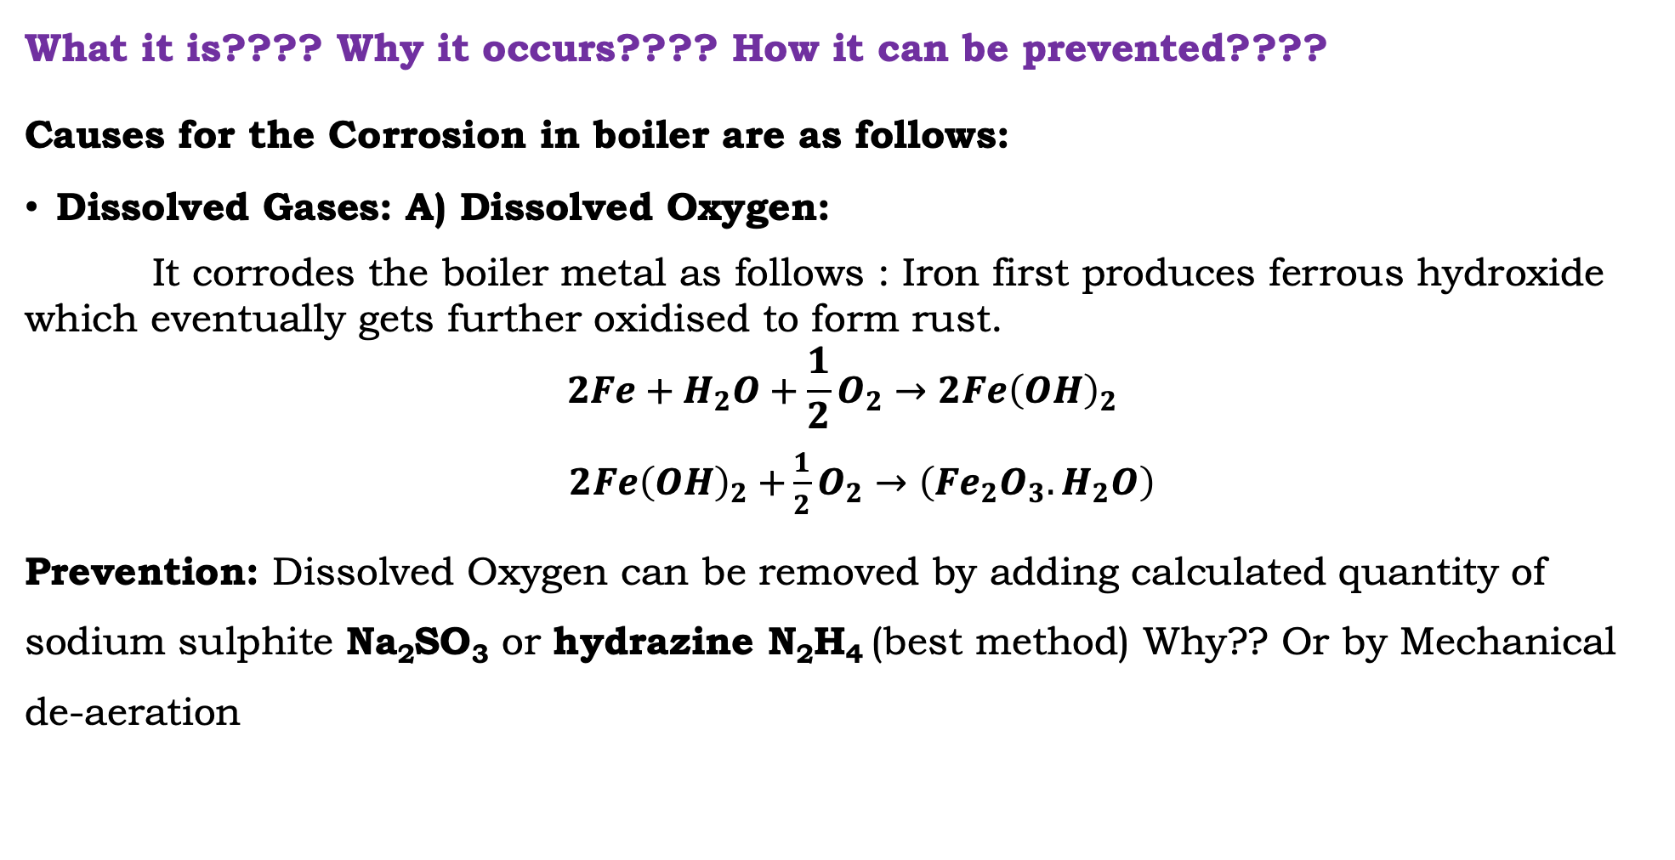
Boiler Corrosion
What it is???? Why it occurs???? How it can be prevented????
Causes for the Corrosion in boiler are as follows:
Dissolved Gases: A) Dissolved Oxygen:
It corrodes the boiler metal as follows : Iron first produces ferrous hydroxide which eventually gets further oxidised to form rust.
$$2Fe+H_{2}O+\frac{1}{2}O_{2}→2Fe{\left(OH\right)}_{2}$$
$2Fe{\left(OH\right)}_{2}$ $+\frac{1}{2}O_{2}→\left({Fe}_{2}O_{3}.H_{2}O\right)$
Prevention: Dissolved Oxygen can be removed by adding calculated quantity of sodium sulphite Na₂SO₃ or hydrazine N₂H₄ (best method) Why?? Or by Mechanical de-aeration

Slide 45
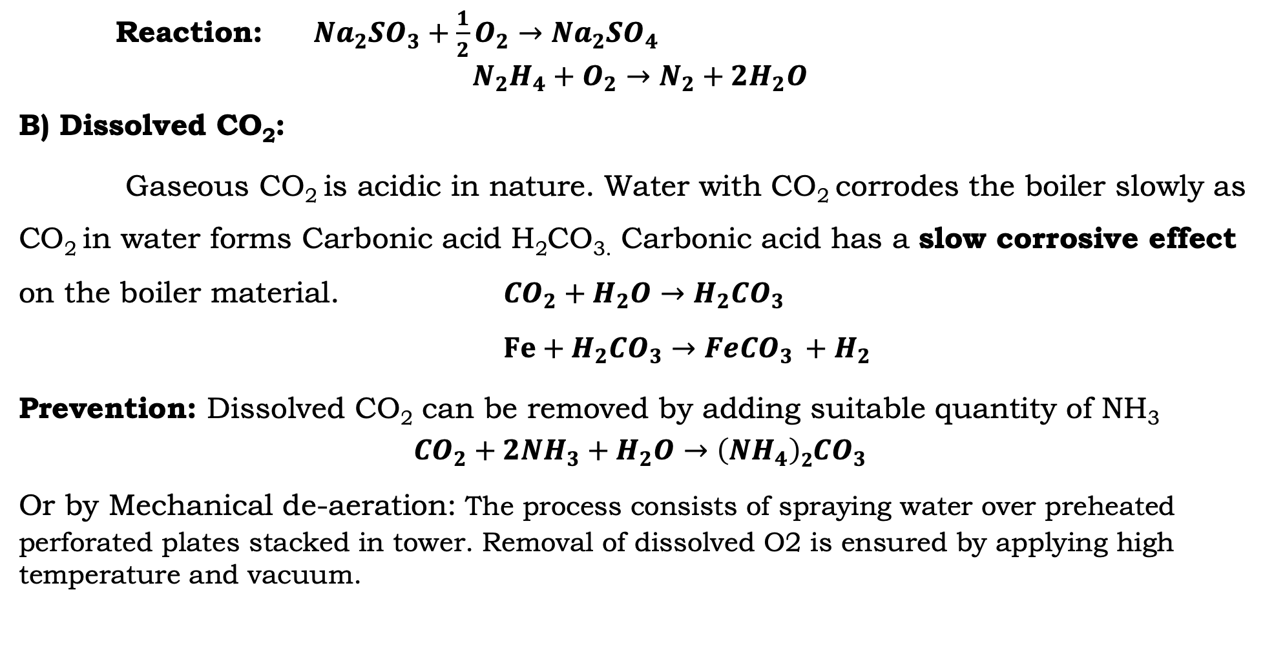
Boiler Corrosion
Reaction: ${Na}_{2}{SO}_{3}+\frac{1}{2}O_{2}→{Na}_{2}{SO}_{4}$
$$N_{2}H_{4}+O_{2}→N_{2}+{2H}_{2}O$$
B) Dissolved CO₂:
Gaseous CO₂ is acidic in nature. Water with CO₂ corrodes the boiler slowly as CO₂ in water forms Carbonic acid H₂CO_{3.} Carbonic acid has a slow corrosive effect on the boiler material. ${CO}_{2}+H_{2}O→H_{2}{CO}_{3}$
$Fe+H_{2}{CO}_{3}→Fe{CO}_{3 }+H_{2}$
Prevention: Dissolved CO₂ can be removed by adding suitable quantity of NH₃
$${CO}_{2}+{2NH}_{3}+H_{2}O→{\left({NH}_{4}\right)2CO}_{3}$$
Or by Mechanical de-aeration: The process consists of spraying water over preheated perforated plates stacked in tower. Removal of dissolved O2 is ensured by applying high temperature and vacuum.

Slide 46
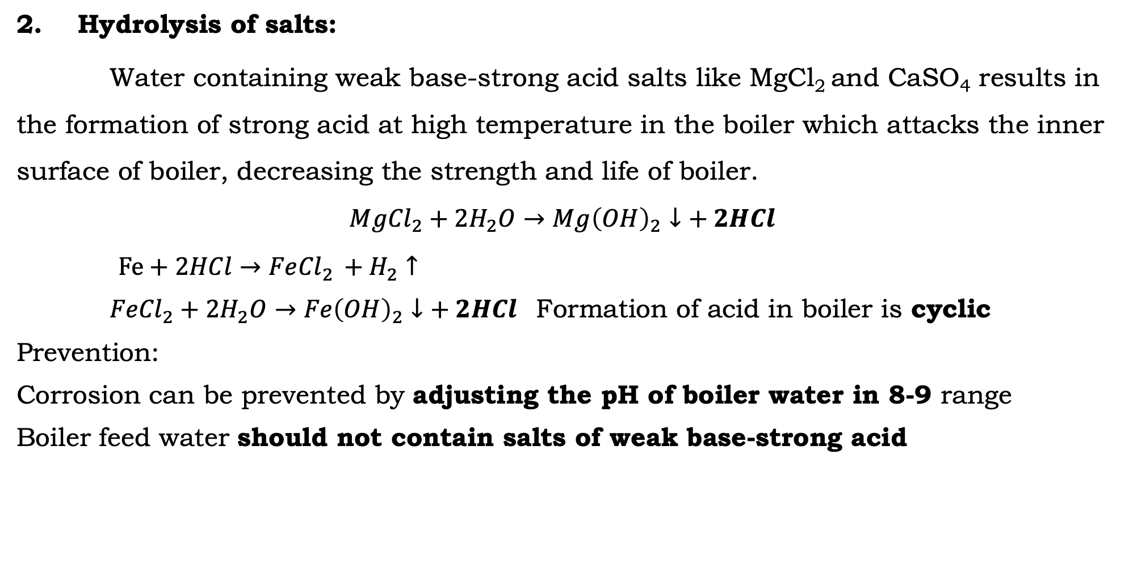
Boiler Corrosion
2. Hydrolysis of salts:
Water containing weak base-strong acid salts like MgCl₂ and CaSO₄ results in the formation of strong acid at high temperature in the boiler which attacks the inner surface of boiler, decreasing the strength and life of boiler.
$${MgCl}_{2}+{2H}_{2}O→{Mg\left(OH\right)}_{2}↓+ 2HCl$$
$Fe+2HCl→Fe{Cl}_{2 }+H_{2}↑$
${FeCl}_{2}+{2H}_{2}O→{Fe\left(OH\right)}_{2}↓+ 2HCl$ Formation of acid in boiler is cyclic
Prevention:
Corrosion can be prevented by adjusting the pH of boiler water in 8-9 range
Boiler feed water should not contain salts of weak base-strong acid

Slide 47
Boiler Corrosion
3. Formation of Galvanic Cells:
Galvanic Cells gets formed in the boiler fittings which are made up of different metals or due to impurities (2 different metals in contact with water)
Prevention: Galvanic Cell formation can be avoided by suspending sacrificial plates (anodes) in boiler water like Zinc plates. Zn being more electropositive than iron, it undergoes corrosion (anode) and protects the boiler metal (cathode)

Slide 48
Caustic Embrittlement
It is the phenomenon in which the boiler material becomes brittle due
to the accumulation of excess alkali in the boiler.
Caustic embrittlement is a form of stress corrosion taking place in boilers operating at high temperature and pressure.
It is caused by high alkalinity of water in the boiler, particularly at those places which are under stress such as rivets, joints and bends with the result that the metal plates become brittle.
When water is softened by lime – soda process, the excess sodium carbonate undergoes decomposition in high pressure boilers leading to the formation of NaOH. Na₂CO₃ + H₂O → 2NaOH + CO₂

Slide 49
Caustic Embrittlement
This NaOH makes the water alkaline.
The alkaline water penetrates into the minute cracks and crevices between the rivets and joints by capillary action.
Inside the cracks, the water evaporates and the concentration of NaOH increases on these sites due to poor circulation of water.
NaOH attacks the iron in boiler material converting it to sodium ferroate (Na₂FeO₂). A small quantity of sodium ferrite (NaFeO₂) is also formed.
Fe + 2NaOH → Na₂FeO₂ + H₂

Slide 50
Caustic Embrittlement
3Na₂FeO₂ + 4H₂O → 6NaOH + Fe₃O₄ + H₂
6Na₂FeO₂ + 6 H₂O + O₂ → 12NaOH + 2Fe₃O₄
Fe₃O₄ + 4NaOH → 2NaFeO₂ + Na₂FeO₂ + 2H₂O
It can be seen that NaOH is regenerated in the process and its concentration keeps on increasing maintaining the required environment.
The caustic embrittlement of the boiler may be explained by assuming the formation of a concentration cell as shown below:
Iron at bends, rivets joints (stressed areas) | Concentrated NaOH solution || Dilute NaOH solution | Iron at plane surface (stress free)
The iron in the anodic area undergoes corrosion and dissolves making the boiler material brittle.

Slide 51
Caustic Embrittlement
Prevention:
By adding tannin or lignin to the boiler water.
These block the minute cracks and prevent the infiltration of NaOH
By using sodium phosphate instead of sodium carbonate for softening water.
By adjusting the pH of boiler water between 8–9.
Use of excess Na₂CO₃ should be avoided in the lime-soda process.
Caustic embrittlement can be prevented if Na₂SO₄ is added to the boiler water, because it is useful in blocking the hair cracks.
Na₂SO₄/NaOH should be used in the ratio 1:1, 2:1 and 3:1 for boilers working at pressure 10, 20 and above 20 atm, respectively.

Slide 52
Priming & Foaming
When boiler produces steam rapidly, droplets of water are carried out
along with the steam
Priming is the process of wet steam formation.
Foaming is the formation of continuous, persistent foam or bubbles on the surface of boiler water.
Priming & foaming generally occurs together
Causes of Priming:
Very high level of boiler feed water
High steam velocity (speed of steam generation)
Presence of excessive foam on the surface
Faulty design of boiler
Sudden drop in steam pressure owing to a high demand for steam

Slide 53
Priming & Foaming
Priming and Foaming:
Causes of Foaming:
High concentration of dissolved salts in boiler feed water
Presence of oil droplets and alkali in boiler feed water
Presence of finely dispersed suspended materials
Violent agitation of boiler feed water
Disadvantages Priming and Foaming :
Priming decreases the efficiency & life of machinery as dissolved salts present in the droplets enter in the parts of machinery
Actual height of boiler water cannot be judged because of foaming
Foaming causes wet steam formation

Slide 54
Priming & Foaming
Prevention of Priming and Foaming:
Priming can be prevented using Softened and filtered water
Maintaining low water levels, priming can be prevented
Avoiding rapid changes in the water level, priming can be minimised
Using steam purifiers, if priming happens
Foaming can be prevented by adding antifoaming agents like castor oil, alcohol
By adding chemicals like sodium aluminate , oil from water can be removed
Blow down operations at appropriate time

Slide 55
Scale and Sludge Formation
Water evaporates continuously inside the boiler and the concentration of dissolved salts increases gradually. When the solution is saturated with respect to the salt concentration, the salts start precipitating out on the inner walls of the boiler. If the precipitate formed is soft, slimy and loose, it is called sludge and
if the precipitate formed is hard and adhering on the inner walls of the boiler it is termed as scale.
SLUDGE: It is soft, slimy and loose precipitate formed on the inner walls of the boiler.

Slide 56
Scale and Sludge Formation
Sludge formation:
(a) Sludges are formed by substances which have greater solubility in hot water than in cold water like MgSO₄, MgCl₂, MgCO₃, CaCl₂ etc.
(b) They are formed at colder parts of the boiler and get collected at places where the flow rate is slow or at bends, plug opening, glass gauge connection, thereby causing even choking of the pipes.
(c) They are poor conductors of heat.
Prevention :
(i) By using softened water.
(ii) By frequently ‘blow-down operation’ (drawing off a portion of the concentrated water from the boiler and replacing it with fresh water)

Slide 57
Scale and Sludge Formation
Disadvantages of sludge formation:
(i) Being poor conductors of heat, they tend to waste a portion of heat generated and thus decreases the efficiency of the boiler.
(ii) Excessive sludge formation disturbs working of the boiler.
(iii) When formed along with scale, they get entrapped in scale and both get deposited as scales.
(iv) It settles in regions of poor water circulation such as pipe connection, plug opening, and glass gauge connection thereby choking the pipes.

Slide 58
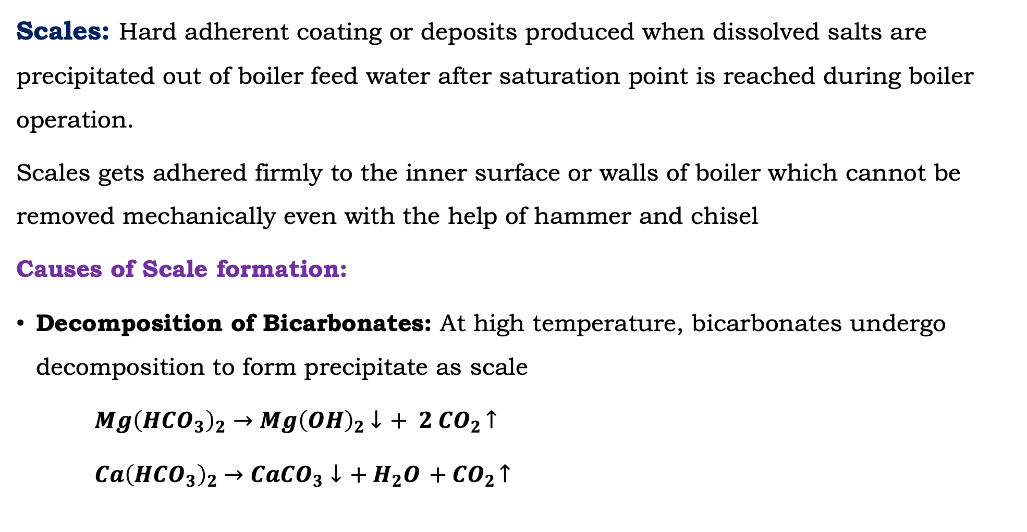
Scale and Sludge Formation
Scales: Hard adherent coating or deposits produced when dissolved salts are precipitated out of boiler feed water after saturation point is reached during boiler operation.
Scales gets adhered firmly to the inner surface or walls of boiler which cannot be removed mechanically even with the help of hammer and chisel
Causes of Scale formation:
Decomposition of Bicarbonates: At high temperature, bicarbonates undergo decomposition to form precipitate as scale
${Mg\left(HCO_{3}\right)}_{2}→{Mg\left(OH\right)}_{2}$ $↓$ $+{ 2 CO}_{2 }↑$
$Ca{\left(HCO_{3}\right)}_{2}$ $→Ca{CO}_{3}↓$ $+{ H}_{2}O$ $+{ CO}_{2 }↑$

Slide 59
Scale and Sludge Formation
CaCO₃ scale is soft and it is the main cause of scale formation in low- pressure boilers. However in higher pressure boilers CaCO₃ is soluble due to the formation of soluble Ca(OH)₂
CaCO₃ + H₂O → Ca(OH)₂ + CO₂
Deposition of CaSO₄ : The solubility of CaSO₄ decreases as temperature increases. CaSO₄ is soluble in cold water and is completely insoluble in superheated water. Therefore, CaSO₄ gets precipitated as hard scale on the hot portion of the boiler.
Hydrolysis of magnesium salts At high temperature, dissolved magnesium salts undergo hydrolysis forming a soft scale of magnesium hydroxide.
MgCl₂ + 2H₂O → Mg(OH)₂ + 2HCl

Slide 60
Scale and Sludge Formation
Formation of calcium and magnesium silicates
Very small quantities of SiO₂ present in hard water react with calcium and magnesium forming calcium silicate (CaSiO₃) and/or magnesium silicate (MgSiO₃). These are hard scales and are extremely difficult to remove.
Removal of scale:
(i) Loosely adhering scale can be removed either by scraper or wire brush or by blow-down operation.
(ii) Brittle scales can be removed by thermal shocks (i.e heating the boiler and then suddenly cooling with cold water).
(iii) Hard and adherent scales can be removed by dissolving in chemicals, for example, CaCO₃ scale can be dissolved by using 5–10% HCl. CaSO₄ scale can be removed by adding EDTA since the Ca-EDTA complex is highly soluble in water.
(iv) By external and internal treatment

Slide 61
Scale and Sludge Formation
Disadvantages of scale formation:
Wastage of fuel Scales have poor thermal conductivity, therefore the rate of heat transfer from boiler to the water inside is greatly reduced. Hence extra heat is to be supplied to the boiler and this increases the fuel consumption.
Wastage of fuel depends upon the thickness of the scale. Greater the thickness of the scale larger is the wastage of fuel.
Lowering boiler safety Due to scale formation which is poor conductor of heat, the boiler is to be over heated to provide steady supply of heat. Overheating makes the boiler material softer and weaker. Therefore distortion of boiler tubes takes place and the boiler becomes unsafe to bear the pressure of the steam (in high-pressure boilers).

Slide 62
Scale and Sludge Formation
Disadvantages of scale formation:
Decrease in efficiency Deposition of scale in the valves and condensers of the boiler, chokes them partially. This results in decrease in efficiency.
Danger of explosion Due to uneven expansion the thick scales crack, as a result water comes in contact with the overheated inner walls of the boiler resulting in excessive steam formation which can lead to boiler explosion.

Slide 63
Unit 1: Water Softening Techniques
Water Softening:
Process of converting hard water into soft water. Softening methods are of 2 types:
Internal Treatment
External Treatment Process: Based on following Principle
1) Precipitation 2) Ion-exchange
a) Zeolite Method or Permutit Process
b) Demineralization or Deionization Method
c) Lime Soda Method (Hot/Cold)

Slide 64
Zeolite Method
Zeolites are also known as permutit and in Greek it means ‘boiling stone’. They occur naturally as hydrated alumino silicate minerals like Na₂O.Al₂O₃. x SiO₂. y H₂O
where x = 2–10 and y is 2–6. They are capable of exchanging reversibly sodium ions for hardness producing ions in water.
1. Natural Zeolites Non porous, amorphous and durable, for example, Natrolite Na₂O.Al₂O₃. 4SiO₂. 2H₂O
2. Synthetic Zeolites Porous with gel-like structure. They are prepared by heating sodium carbonate (Na₂CO₃), alumina (Al₂O₃) and silica (SiO₂).

Slide 65
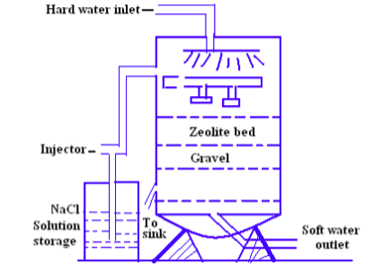
Zeolite Softener

Slide 66
Zeolite Method
Process Hard water is percolated at a specified rate through a bed of zeolite stacked in a cylindrical unit. The hardness causing elements (Ca²⁺, Mg²⁺ etc) are retained by zeolite as CaZe and MgZe, while the outgoing water contains sodium salts.
The chemical reactions involved are Na₂Ze + Ca(HCO₃)₂ → CaZe + 2 NaHCO₃ Na₂Ze + Mg(HCO₃)₂ → MgZe + 2NaHCO₃ Na₂Ze + CaCl₂ (or CaSO₄) → CaZe + 2NaCl (or Na₂SO₄)
Na₂Ze + MgCl₂ (or MgSO₄) → MgZe + 2NaCl (or Na₂SO₄)

Slide 67
Zeolite Method
After some time, all the sodium ions in zeolite are replaced by Ca and Mg ions giving CaZe/ MgZe. Such a zeolite bed is unable to soften water further and is said to be exhausted. It has to be regenerated to enable it to soften water again. It may be noted that the water obtained by zeolite process is used mostly for laundry purpose; it cannot be used in boilers.
Regeneration
When the zeolite bed is exhausted the supply of hard water is stopped and it is regenerated by treating with a concentrated brine (10% NaCl) solution.
CaZe (or MgZe) + 2NaCl → Na₂Ze + CaCl₂ (or MgCl₂)
(exhausted zeolite) (Brine) Reclaimed (Washings)

Slide 68
Zeolite Method
The washings (containing CaCl₂, MgCl₂, etc.) are led to drain and the regenerated zeolite bed is used again for softening. (NaNO₃, KCl, KNO₃, etc. can also be used for regeneration instead of NaCl, but NaCl is mostly used because of its low cost and the products of regeneration process (CaCl₂ or MgCl₂, ) are highly soluble and can be easily rinsed out of the zeolite bed).
By knowing the amount of NaCl used for regeneration of the exhausted zeolite bed, the hardness of the water sample can be calculated by using the formula.
Hardness (H) = 50 × m× V₁ ×10³ /58.5×V
V = Total Volume of water softened in litres;
V₁ = Total volume of NaCl used for regeneration and
M = amount of NaCL in g/L present in V₁

Slide 69
Zeolite Method
Advantages of Zeolite Process
Hardness is removed almost completely, and the residual hardness is about 10 ppm.
The equipment is compact and occupies less space.
It is a clean and rapid process. Sludge is not formed as the impurities are not precipitated.
It requires less skill for maintenance as well as operation.

Slide 70
Zeolite Method
Limitations and Disadvantages of Zeolite Process
Turbid water cannot be used as turbidity clogs the pores of zeolite bed making it inactive.
Mn²⁺ and Fe²⁺ present must be removed first because these ions react with zeolite bed to give manganese and iron zeolites which cannot be easily regenerated.
Mineral acids, if present in water, destroy the zeolite bed and hence they must be neutralised with soda in advance.
This method does not remove anions. The bicarbonates present in hard water get converted into NaHCO₃ which goes into soft water effluent. If this water is used in boiler, NaHCO₃ dissociates as NaOH and CO_{2.} NaOH leads to caustic embrittlement and CO₂ makes the water acidic and corrosive.
The treated water contains more sodium salts.
Moreover, high cost of the plant and material also acts as limiting factor.

Slide 71
Numericals on Zeolite Method
A zeolite softener was used to remove the hardness of 95,000 liters of hard water completely. The softener required 475 liters of NaCl solution containing 18 g/liter of NaCl for regeneration. Calculate the hardness of hard water in ppm.
(Hardness (H) = 76.92 ppm)
An exhausted zeolite softener was regenerated by 325 liters of NaCl solution containing 60 g/liter of NaCl. How many liters of hard water of hardness 250 mg/L can be softened by the zeolite softener.
(Total volume of hard water softened = 66666.67 liters)

Slide 73
Numericals on Zeolite Method
1. A zeolite softener was completely exhausted and was regenerated by passing 100 liters of NaCl solution containing 120 g/liter of NaCl. How many liters of sample of water of hardness 500 ppm can be softened by this softener.
[Ans 20512.8 liters]
2. A zeolite softener was completely exhausted after softening 145,000 liters of hard water. To regenerate the zeolite softener 540 liters of NaCl solution containing 110 g/liter of NaCl is required. Calculate the hardness of one liter water sample in ppm.
[Ans 350.13 ppm]
3. 200 liters of NaCl solution containing 85 g/liter of NaCl was required to regenerate a completely exhausted zeolite softener. How many liters of hard water of hardness 600 ppm can be softened by the softener.
[Ans 24216.5 liters]
4. When a zeolite softener was completely exhausted it was regenerated by passing 200 liters of NaCl solution containing 120 g/liter of NaCl. How many liters of a sample of water of hardness 550 mg/liter can be softened by the zeolite softener before regenerating it again.
[Ans 37296.037 liters]

Slide 74
Water Softening Techniques
Demineralization or Deionization Method:
Principle: Ion Exchange
Ion Exchange Process: Ion exchange process is defined as the reversible exchange of ions in the structure of an ion exchanger to ions in solution that is brought in contact with it.
The resins used for the purpose are called ion exchange resins.
Resins are porous, insoluble, cross linked, long chain organic polymers capable of exchanging ions.
Two types of resins are employed for the softening of water.

Slide 75
Water Softening Techniques
(i) Cation exchange resin: They are materials capable of exchanging a cation in their structure to the cation in solution. For softening of water, the resins used should be capable of exchanging H+ ions in their structure to other cations in solution.
Commonly used resins are styrene divinyl benzene copolymers, which on sulphonation or carboxylation become capable of exchanging hydrogen ions with the cations in water. They are represented as R–H⁺ (R represents insoluble polymer matrix and H is the exchangeable ion).
(ii) Anion exchange resin : They are materials capable of exchanging an anion in their structure (for water softening the exchangeable anion should be OH– ion) to anion in solution.
Anion exchangers employed for water softening are styrene divinyl benzene copolymers, which contain basic functional group such as amino or quaternary ammonium groups as an integral part of the resin matrix. These after treatment with dilute NaOH solution become capable of exchanging OH– ions with the anions in water. They are represented as R⁺OH– (where, R⁺ is the insoluble polymer matrix and OH– is the exchangeable ion).

Slide 76
Water Softening Techniques
Process : The hard water is first passed through a column containing cation exchange resin. All cations are removed and equivalent amount of H⁺ ions are released from this column to water. The water coming out of this chamber has low pH.
The exchange reactions :
2RH⁺ + Ca²⁺ → R₂Ca + 2H⁺
2RH⁺ + Mg²⁺ → R₂Mg + 2H⁺
After this the water is passed into second column containing anion exchange resin. All the anions are removed and an equivalent amount of OH⁻ ions are released.
ROH + Cl⁻ → RCl + OH⁻
ROH + SO₄²⁻ → R₂SO₄ + 2OH⁻
ROH + CO₃^{2–} → R₂CO₃ + 2OH⁻

Slide 77
Water Softening Techniques
Process :
The H⁺ ions released from cation exchange column and OH– ions released from anion exchange column combine to produce water molecule.
H⁺ + OH– → H₂O
The water coming out of the exchanger is free from all cations (except H⁺) and anions (other than OH–).
This ion free water is known as deionised water or demineralised water and has a neutral pH.
Regeneration: After some time, the resin loses all its H⁺ and OH– ions and then its capacity to exchange ions is lost. In such a condition they are said to be exhausted.

Slide 78
Water Softening Techniques
The exhausted cation exchange resin is regenerated by passing a solution of HCl or H₂SO₄.
R₂Ca + H₂SO₄ / 2HCl → 2RH + CaSO₄/CaCl₂
R₂Mg + H₂SO₄ / 2HCl → 2RH + MgSO₄/MgCl₂
The column is then rinsed with distilled water to remove the salts formed. Ideally, HCl is used for regeneration as CaCl₂ and MgCl₂ are more soluble.
The anion exchange resin is regenerated by passing a dilute solution of NaOH and then washing with distilled water
R₂SO₄ + 2NaOH → 2ROH + Na₂SO₄
RCl + NaOH → ROH + NaCl
NaCl, Na₂SO₄ are removed by washing with distilled water.

Slide 79
Water Softening Techniques
Advantages
The process can be used to soften highly acidic or alkaline water.
Unlike zeolite process the soft water does not contain sodium ions.
It removes all cations and anions other than H+ and OH– ions.
All ionisable impurities are removed.
It produces water of very low residual hardness (about 2 ppm).
Disadvantages
The process is expensive, both the equipment and resins are costly.
Turbid water decreases the efficiency of the process.

Slide 80
Unit 1: Purification of Water
Purification of Water: Performed by 2 processes
Membrane Process (RO & Electrodialysis)
Thermal Process (Distillation)
Membrane Process: Membranes are used in the water purification
Membranes act as barrier. Membranes blocks the different size molecules
Membranes are Organic, Inorganic and Biological (Kidney Tissues)
Types of Membranes:
Permeable Impermeable
Semi-permeable Selectively Permeable
Notes:
https://www.youtube.com/watch?v=8bzYETuc3bY

Slide 81
Unit 1: Purification of Water
Key differences in Membranes:
Permeable Membrane: Membrane which allows passage of all materials through it
Impermeable Membrane: Membrane which does not allow the passage of materials through it.
Semi-permeable membrane: Membrane which allows some materials (certain molecules or ions) to pass through it by diffusion or facilitated diffusion while blocking the passage of other molecules.
Selectively Permeable: A membrane that is selectively permeable, i.e., being permeable to only certain molecules or ions and not to all molecules or ions.
Notes:
https://www.youtube.com/watch?v=8bzYETuc3bY

Slide 82
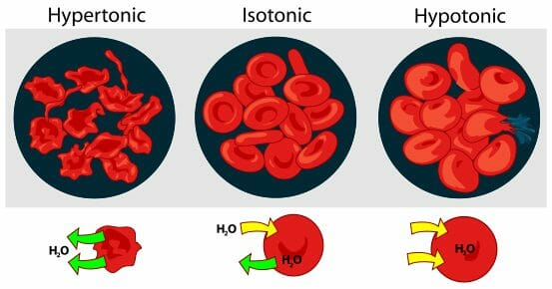
Unit 1: Reverse Osmosis
Osmosis: Osmosis is the spontaneous net movement of solvent molecules through a selectively permeable membrane into a region of higher solute concentration due to difference in osmotic pressure, in the direction that tends to equalize the solute concentrations on the two sides. Eg.: Roots of the plants absorbing water from the soil
Notes:
Osmosis is a type of diffusion that, in biology, is usually related to cells. Diffusion is when molecules or atoms move from an area of high concentration to an area of low concentration. Osmosis is when a substance crosses a semipermeable membrane in order to balance the concentrations of another substance. In biology, this is usually when a solvent such as water flows into or out of a cell depending on the concentration of a solute such as salt. Osmosis happens spontaneously and without any energy on the part of the cell.
Solvents and Solutes
Osmosis deals with chemical solutions. Solutions have two parts, a solvent and a solute. When solute dissolves in a solvent, the end product is called a solution. Salt water is an example of a solution; salt is the solute, and water is the solvent.
Types of Solutions
In biology, there are three different types of solutions that cells can be in: isotonic, hypotonic, and hypertonic. Different types of solutions have different impacts on cells due to osmosis.
Isotonic
An isotonic solution has the same concentration of solutes both inside and outside the cell. For example, a cell with the same concentration of salt inside it as in the surrounding water/fluid would be said to be in an isotonic solution. Under these conditions, there is no net movement of solvent; in this case, the amount of water entering and exiting the cell’s membrane is equal.
Hypotonic
In a hypotonic solution, there is a higher concentration of solutes inside the cell than outside the cell. When this occurs, more solvent will enter the cell than leave it to balance out the concentration of solute.
Hypertonic
A hypertonic solution is the opposite of a hypotonic solution; there is more solute outside the cell than inside it. In this type of solution, more solvent will exit the cell than enter it in order to lower the concentration of solute outside the cell.
How Osmosis Affects Cells
Osmosis affects plant and animal cells differently because plant and animal cells can tolerate different concentrations of water. In a hypotonic solution, an animal cell will fill with too much water and lyse, or burst open. However, plant cells need more water than animal cells, and will not burst in a hypotonic solution due to their thick cell walls; hypotonic solutions are ideal for plant cells. The optimal condition for an animal cell is to be in an isotonic solution, with an equal amount of water and solutes both inside and outside. When a plant cell is in an isotonic solution, its cells are no longer turgid and full of water, and the leaves of the plant will droop. In a hypertonic solution, water will rush out of both animal and plant cells, and the cells will shrivel (in plants, this is called plasmolyzation). This is why slugs and snails shrivel and die when salt is sprinkled onto them; water leaves their cells in order to balance the higher concentration of salt outside the cells.
This figure shows the effects of osmosis on red blood cells:
Examples of Osmosis
Osmosis is how plants are able to absorb water from soil. The roots of the plant have a higher solute concentration than the surrounding soil, so water flows into the roots. In plants, guard cells are also affected by osmosis. These are cells on the underside of leaves that open and close to allow gas exchange. When the plant’s cells are full of water, the guard cells swell and open the stomata, small holes that allow the plant to take in carbon dioxide and release oxygen.
Osmosis can have adverse effects on animals such as fish. If freshwater or saltwater fish are put into water that has a different salt concentration than they are used to, they will die from having too much water enter or leave their cells. Osmosis can affect humans as well; in a person infected with cholera, bacteria overpopulate the intestines, leaving the intestines unable to absorb water. The bacteria actually reverse the flow of absorption because osmosis causes water to flow out of the intestinal cells instead of in. This causes severe dehydration and sometimes death.
Related Biology Terms
Diffusion – a process by which molecules move from areas of high concentration to areas of low concentration. Osmosis is one type of diffusion.
Solution – a mixture made up of two or more substances where one substance, a solute, is dissolved into another substance, a solvent.
Semipermeable – also known as selectively permeable, this means that only certain substances can pass through a barrier. Cell membranes are semipermeable.
Cell – the smallest unit that makes up a living organism. It includes various different parts called organelles that have functions such as storing genetic material and making proteins and energy.
Test Your Knowledge of Osmosis
1. When a cell contains a lower concentration of solute than the solvent surrounding it, that cell is said to be in what kind of solution? A. Hypertonic B. Hypotonic C. Isotonic
Answer to Question #1
2. Isotonic conditions are ideal for which cells? A. Plant cells B. Animal cells C. Both D. Neither
Answer to Question #2
3. What happens to an animal cell in a hypotonic solution? A. There is no negligible effect, as the concentration of solute on both sides of the membrane is the same. B. Water will rush out of the cell, making it shrivel. C. Water will rush into the cell, and it will become turgid. D. Water will rush into the cell, causing it to lyse (burst).

Slide 83
Unit 1: Reverse Osmosis
Reverse Osmosis System:
It is a water purification process
It uses a partially permeable membrane to separate ions, unwanted molecules and larger particles from contaminated or unfiltered water to obtain potable water.
A semipermeable membrane has small pores that block contaminants but allow water molecules to flow through, which consists of very thin films of cellulose acetate, polymethacrylate, polyamides etc.
Water flows from the more concentrated side (more contaminants) of the RO membrane to the less concentrated side (fewer contaminants) to provide clean drinking water.
The fresh water produced is called the permeate. The concentrated water left over is called the waste or brine.
In Reverse osmosis, pure water (solvent) is separated from it’s contaminates, rather than removing contaminates from the water. For example, when pressure is applied to a volume of saltwater during reverse osmosis, the salt is left behind and only clean water flows through.
https://www.youtube.com/watch?v=4RDA_B_dRQ0
Notes:
https://www.youtube.com/watch?v=8bzYETuc3bY

Slide 84
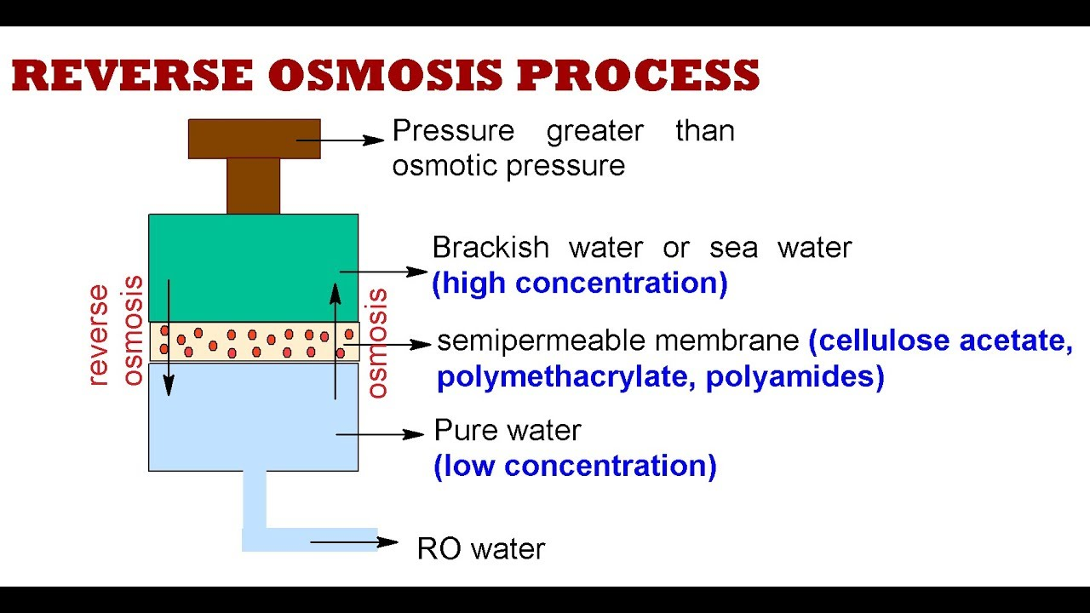
Unit 1: Reverse Osmosis
https://www.youtube.com/watch?v=8bzYETuc3bY

Slide 85
Unit 1: Reverse Osmosis
Distinct Advantages:
It removes ionic as well as nonionic, colloidal and high MW organic matter.
It removes colloidal silica which is not removed by demineralisation
Maintenance cost is almost entirely on the replacement of semi permeable membrane
Life of membrane is quite high almost 2 years
Membranes can be replaced within few minutes
Low capital cost low operating cost and high reliability

Slide 86
Unit 1: Reverse Osmosis
Home Unit:

Slide 87
Unit 1: Electrodialysis
Electrodialysis:
For more efficient separation usually ion selective membranes are employed
An ion selective membrane has permeability for only one kind of ions with specific charge
Cation selective membrane is permeable to cation only because of presence of charged fixed functional groups inside the membrane which rejects anions
Similarly, anion selective membrane has positively charged fixed functional groups which permeate anions only and rejects cations
https://www.youtube.com/watch?v=wYkkLUckmg4

Slide 88
Unit 1: Electrodialysis
Electrodialysis:
Electro Dialysis (ED) is a membrane process, during which ions are transported through semi permeable membrane, under the influence of an electric potential.
By placing multiple membranes in a row, which alternately allow positively or negatively charged ions to flow through, the ions can be removed from wastewater.
It is a method in which ions (of the salts presents) are pulled out of the salty water by passing direct current using electrodes and thin rigid plastic membranes (natural or synthetic)
When direct electric current is passed through saline water the cations move towards negative pole (or cathode) while the anions start moving towards the positive pole (or anode) through its membrane
As a result, the concentration of brine decreases in the central compartment while it increases in the side compartment

Slide 89
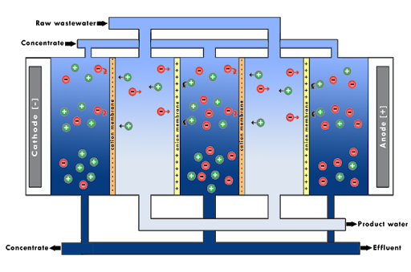
Unit 1: Electrodialysis
Ref:http://waterions.aceenvironment.com
https://www.youtube.com/watch?v=AFTWjU04yg4

Slide 90
Unit 1: Electrodialysis
Electrodialysis Process:
An Electro dialysis cell consist of large number of paired sets of rigid plastic membranes.
Saline water is passed under pressure of about 5 to 6 kg/sq.m between membrane pairs and an electric field is applied perpendicular to the direction of water flow.
Fixed positive charges inside the membrane repel positively charged ions yet permit negatively charged ions to pass through.
Similarly, the fixed negative charged inside the other type of membrane repel negatively charged ions yet permit cations to pass through

Slide 91
Unit 1: Electrodialysis
Electrodialysis:
Water in one compartment of cell is deprived of its salt while the salt concentration in adjacent compartment increases.
Thus, we get alternate streams of pure water and concentrated brine.
https://www.youtube.com/watch?v=eW5efz2LTOo
Advantages:
Compact unit
Economical cost of installation and operation
Best suited if electricity is easily available

Slide 92
Unit 1: Electrodialysis
Limitations:
Non-ionic matter cannot be removed
Colloidal, silica cannot be removed
Applications of Electrodialysis:
Used for conversion of sea water to potable water
Desalination of boiler feed water for reuse
Salt recovery from salt concentrated water

Slide 93
Design the Questions
Questions on RO & Electrodialysis:
Mention water purification processes
What is the principle of reverse osmosis?
How is sea water purified in reverse osmosis?
Explain desalination by reverse osmosis method
Explain electrodialysis for desalination of water with the help of a neat diagram

Slide 94
Thank You

